Slide 1
Buy America & buy American
Notes:
Intros

Slide 2
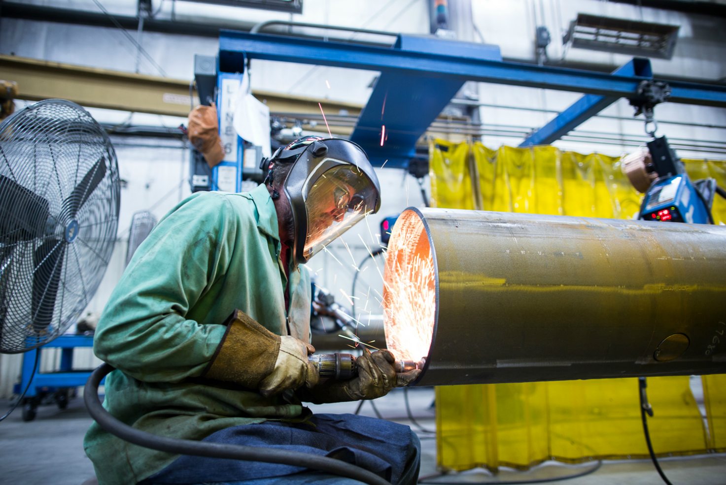
Objectives
Introduction to Buy America and Buy American
Understand the rules and regulations of Buy America compliancy
Understand the rules and regulations of Buy American compliancy

Slide 3
Intro to Buy America and Buy American
What Are They?
When To Comply
Buy America and Buy American are regulations to ensure that transportation infrastructure projects are built with American-made products.
1983 - Buy America Act regulates federal agency and third-party contractors using federal funds. 100% of the manufacturing must be done in the United States
1933 - Buy American Act has a two part test:
The end product is manufactured in the US
More than 50% of the cost of all parts are manufactured in the US
Buy America – Applies to purchases related to rail or road transportation.
- Highways
- Railways
- Rapid Transit Systems
Buy American – Requires the US government to prefer US made products in its purchases. This goes beyond transportation purchases.

Slide 4
Buy America
01
Overview

Slide 5

Buy America & FHWA
“Funds authorized for Federal-aid highway projects may not be obligated unless the steel, cement, and manufactured products used in such products are produced in the United States.”
Federal Highway Administration
23 USC § 313
23 CFR §635.410 (Regulatory Provisions)

Slide 6
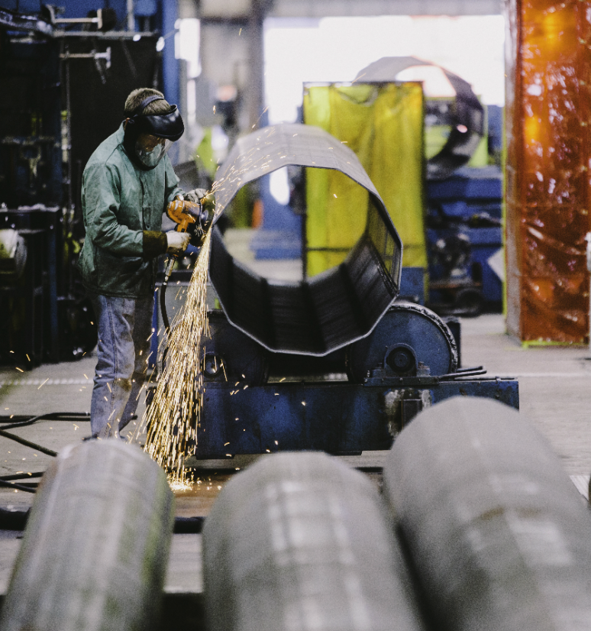
Buy America & FHWA
What manufacturing is involved?
Applies to all iron and steel products and their coatings which are permanently incorporated in a federal highway construction product.
All manufacturing processes must take place domestically. If a domestic product is taken out of the country for any process, it becomes foreign source material.

Slide 7
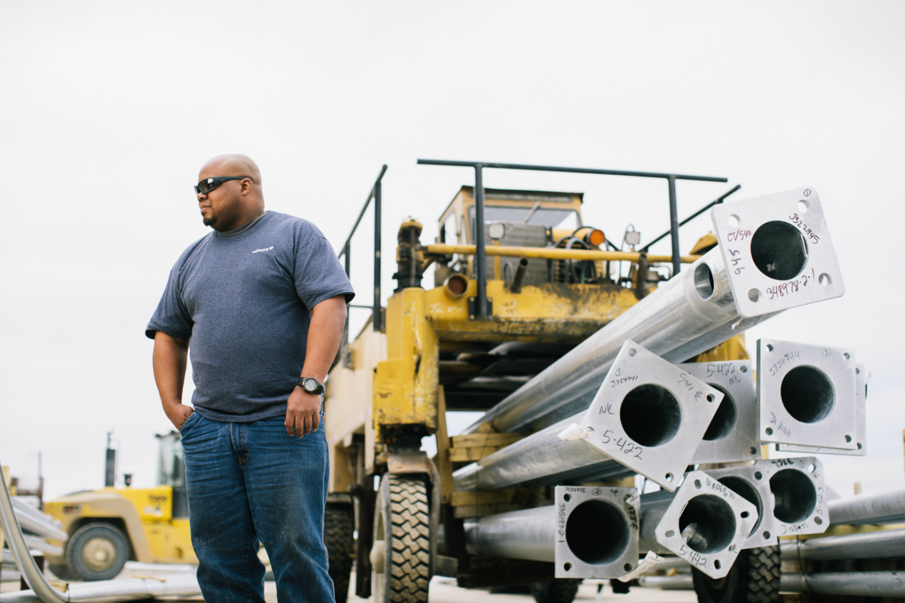
Buy America & FHWA
What products are involved?
Manufactured products include:
Any item that must undergo one or more manufacturing processes before the item can be used in a highway project.
A product utilized as a stand-alone product, or as a component within a more complex assembly
Does NOT apply to raw materials.

Slide 8
FHWA Waiver Options
Public Interest
1/10th of 1%
The application of the Buy America provisions would be inconsistent with the public interest
The cost of such material does not exceed 1/10th of 1% (0.1 %) of the total contract cost or $2,500, whichever is greater.
Quantity and Quality
25% Less Expensive
Iron and steel material/products are not produced in the United States in sufficient and reasonably available quantities which are of satisfactory quality
The total project bid using foreign source materials is 25% less than the lowest total bid using domestic materials.
Project specific waivers must be requested by Local Public Agency or State DOT and approved by Regional Administrator.
In limited circumstances, the Secretary of Transportation may issue nationwide waiver.

Slide 9
Additional Buy America Acts
Federal Aviation Administration (FAA)
49 U.S.C. § 50101
Federal Railroad Administration (FRA)
49 U.S.C. Chapters 244, 246
National Railroad Passenger Corporation (AMTRAK)
49 U.S.C. § 24305
Federal Transit Administration (FTA)
49 U.S.C. § 5323(j) (Rolling Stock)

Slide 10
Buy American
02
Overview

Slide 11
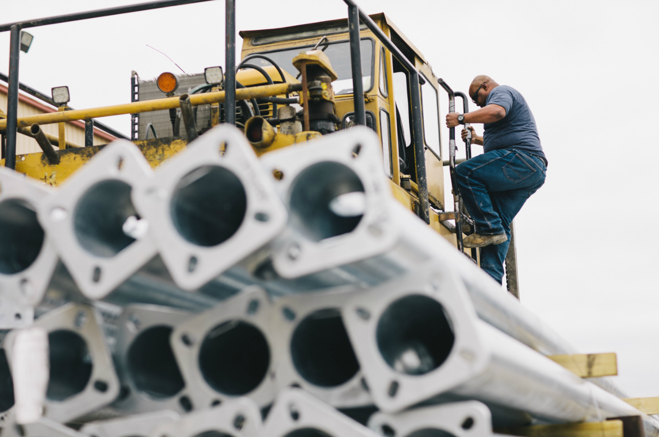
Buy American (1933)
Overview
Major domestic preference statute governing procurement by the federal government.
Enacted in 1933 and only substantively amended 4 times since.
Federal government is required to buy domestic “articles, materials, and supplies” when they are acquired for public use.
Different regulations for supply contracts and construction contracts.

Slide 12
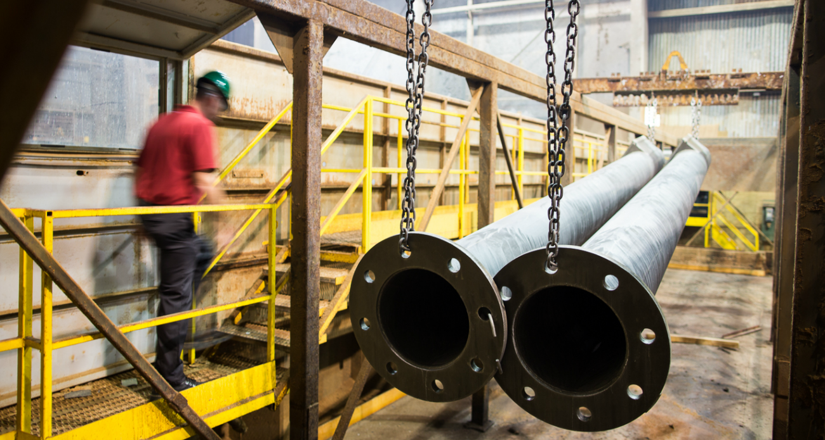
Buy American – Domestic vs Foreign
Unmanufactured
Manufactured
Unmanufactured Product: Will be deemed a domestic product if it has been mined or produced in the United States.
Manufactured product: Will be deemed to be domestic if they have been manufactured in U.S. from components “substantially all” of which have been mined, produced or manufactured in U.S.
* Substantially all = costs of foreign components does not exceed 50% of the cost of all components

Slide 13
American Recovery and Reinvestment Act
The ARRA was a domestic stimulus package signed in 2009 in response to the world recession.
Infrastructure Investment
Periodically, additional Acts will influence or include Buy America / Buy American regulations, like the ARRA. The ARRA is administered by the Office of Energy Efficiency and Renewable Energy (EERE).
Transportation:
Water, sewage, environment, and public lands:
Government facilities:
Communications, information, and security technologies:
Energy infrastructure:
$48.1 billion
$18 billion
$7.2 billion
$10.5 billion
$21.5 billion
None of the funds appropriated by this Act may be used for the construction, alteration, maintenance, or repair of a public building or public work unless all of the iron, steel, and manufactured goods used in the project are produced in the United States.
Funds are available until the investment runs out.

Slide 14
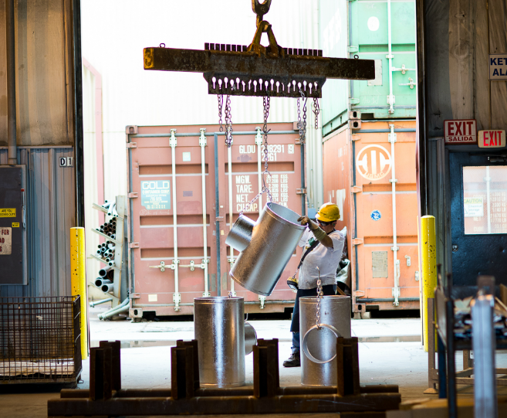
Buy American – ARRA 2009
What is a manufactured good?
A good brought to the construction site for incorporation into the building or work that has been processed into a specific form and shape; or combined with other raw material to create a material that has different properties than the properties of the individual raw materials.

Slide 15
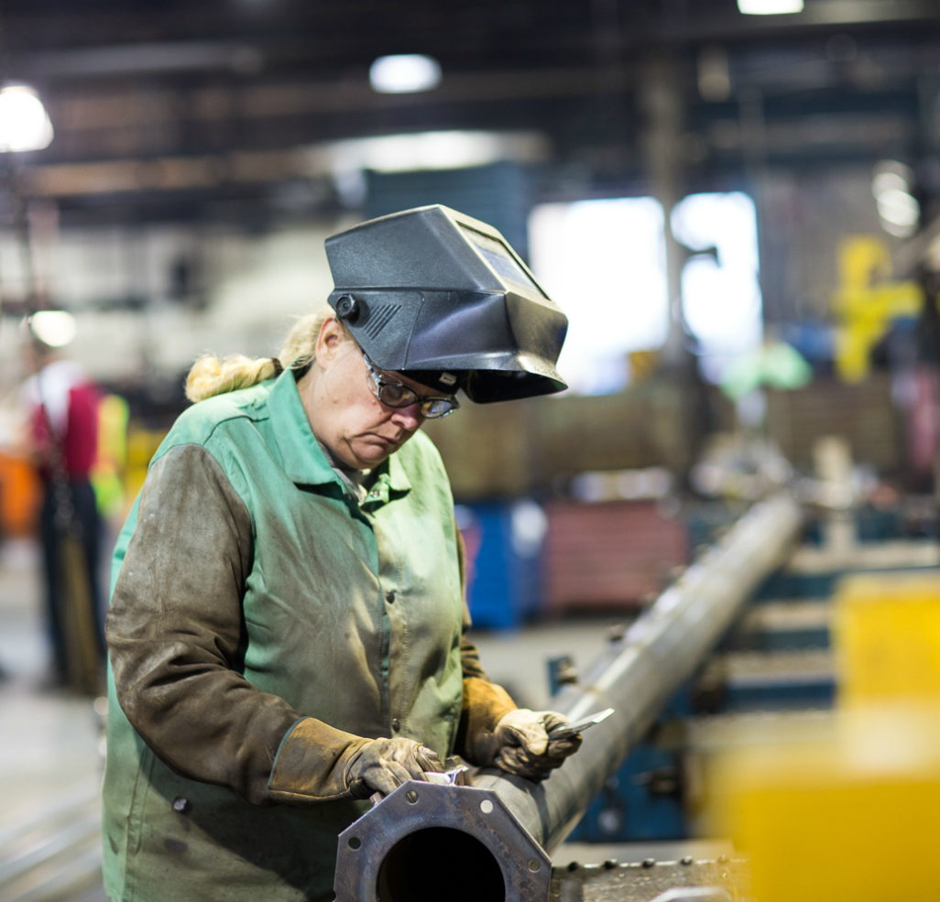
Buy American – ARRA 2009
Origin of the Good
Importantly, no requirement with regard to the origin of components or subcomponents in manufactured goods or products, so long as the manufacture of the goods occurs in the United States.
ARRA requirements will not apply if the parts are:
Components of a larger manufactured good that is domestically manufactured
‘Substantially transformed’ in the United States

Slide 16
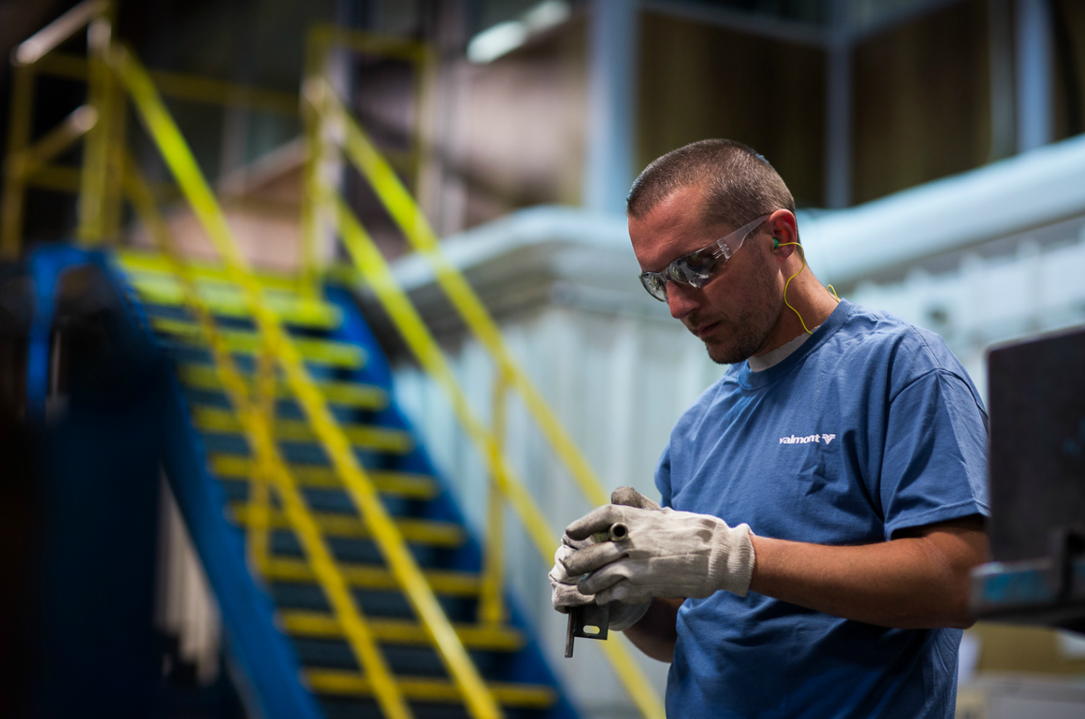
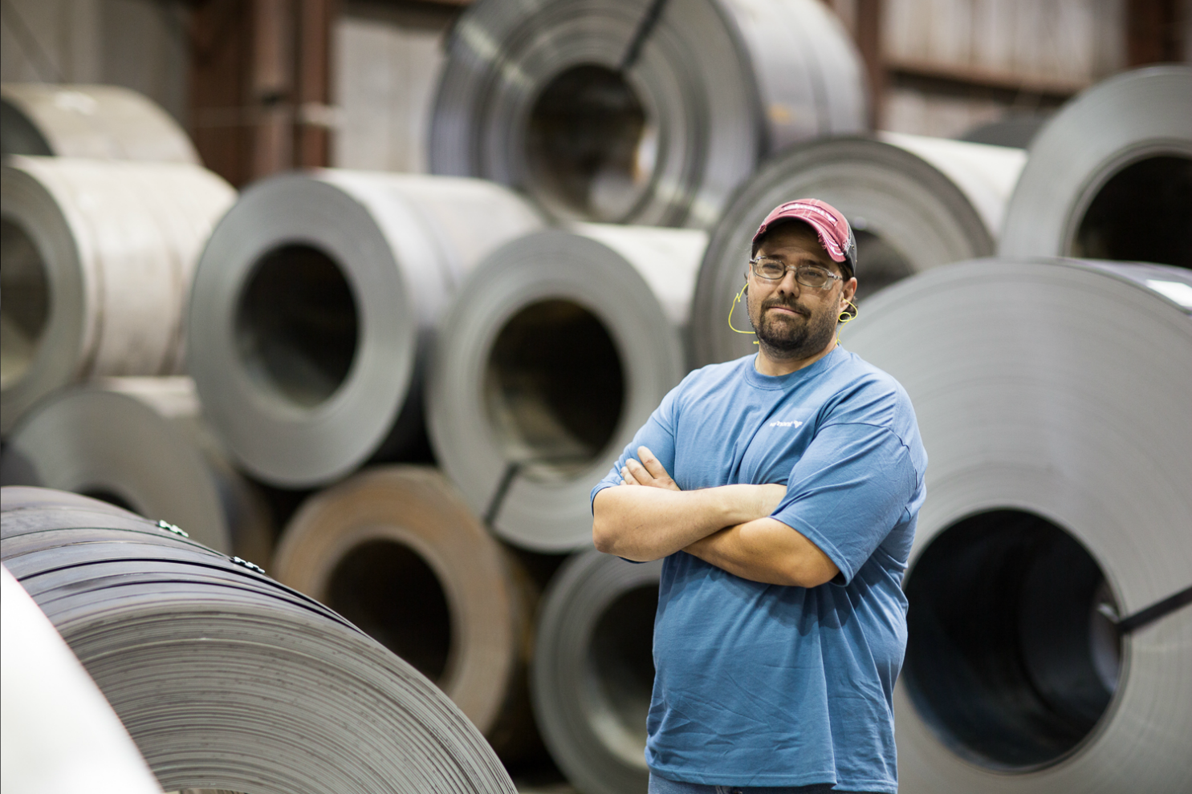
Substantial Transformation
“Substantial transformation” considers whether a product is transformed into a new and different article of commerce with a name, character or use distinct from the article from which it was transformed.
This is a highly fact dependent question, and the U.S. Customs and Border Protection has issued extensive guidance on what does and does not constitute “substantial transformation.”

Slide 17
Buy American - Exceptions
Non-availability: Iron, steel, or manufactured goods are not produced in the United States in sufficient and reasonably available (commercial) quantities and of satisfactory quality;
Unreasonable Cost: Inclusion of iron, steel, or manufactured goods produced in the United States will increase the cost of the overall project by more than 25%;
Public Interest: Applying the Buy American provision is inconsistent with the public interest.
Products for use outside of the United States
Procurements under $2500

Slide 18
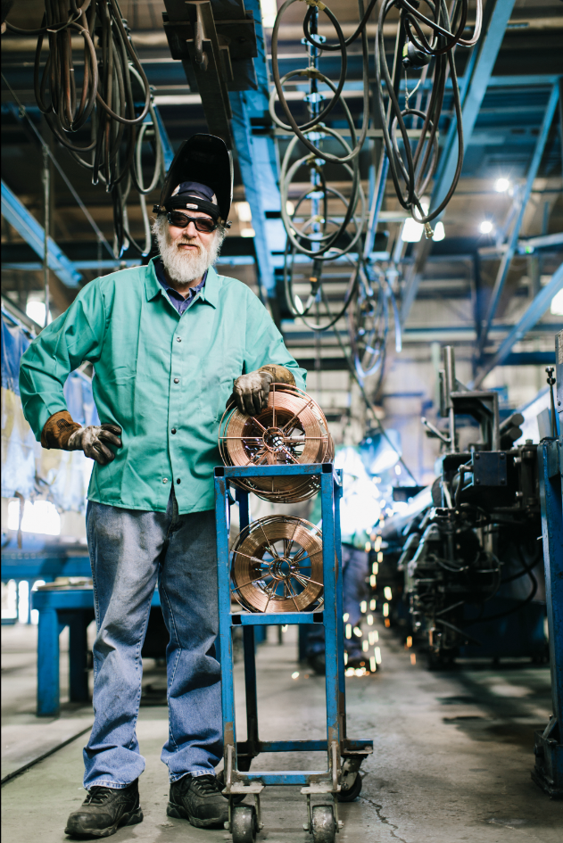
Buy American - Exceptions
The office of Energy Efficiency and Renewable Energy (EERE) has also issued a waiver for incidental items that comprise a de minimis amount of the total cost of the iron, steel and manufactured goods used in a project; up to a limit of no more than 5% of the total costs of the iron, steel and manufactured goods used in and incorporated into a project.
If the Department of Energy issues a waiver, it will be published in the Federal Register

Slide 19
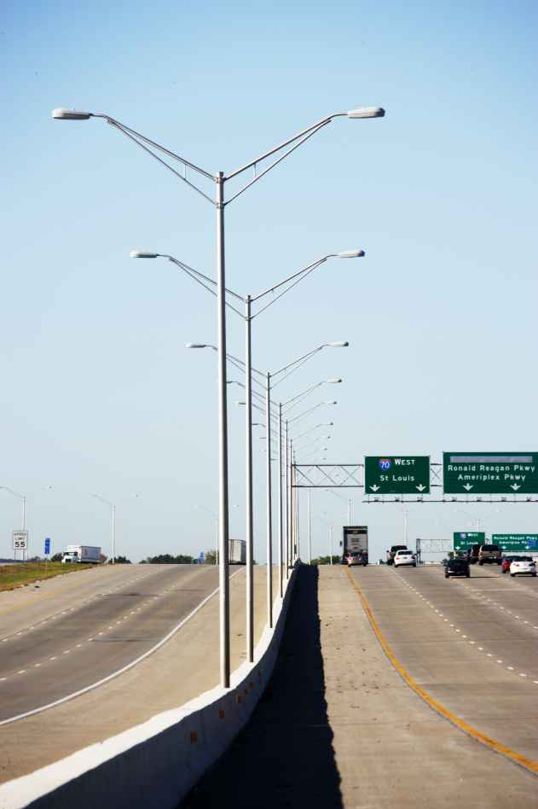
Exceptions to the Rule
If states or cities need access to the available funds, they must follow the Buy America / Buy American mandates set by the Federal Government.
Cities like New York City and Tuscon, Arizona don’t need federal assistance. Therefore, they develop their own specifications and regulations. They in turn, do not receive any federal funding.
Valmont will assume all DOT jobs are Buy America unless told otherwise.

Slide 20
Summary
Buy America
Buy American
Applies to purchases related to rail or road transportation.
Managed by the FHWA.
States may have additional Buy America/Buy Local requirements
100% of product and manufacturing must come from United States. If the product leaves the US, it voids Buy America compliancy.
Applies to all iron and steel products and their coatings.
Requires the US government to prefer US made products in all of its purchases.
States may have additional Buy American/Buy Local requirements
51% of the total cost of the products must be produced in the US.
Product may be deemed domestic if it undergoes “substantial transformation”

Slide 21
THANK YOU!
www.valmontstructures.com

